Slide 1
E-Commerce
Supervision : D.Hagar Saleh

Slide 2
Abstract :-
The idea of the project is based on building a complete website on e-commerce to promote products by the admin and present it to the customer, and the admin´ability to add product and modify it afterwards when needed. The user registers on the site to be able to book it and then buy it.

Slide 3
Website include :-
E-Commerce
As a complete website using HTML,CSS, JAVASCRIPT and PHP codes. And SQL QUERY to retrieve the required data from the database

Slide 4
Website pages include :-
/01
Header
/02
Section
/03
Footer
E-Commerce
It contains the logo and the navigation bar.
It contain many pages as About us ,Contact us ,etc..
Copyright &copy; 2022 –
E-Commerce

Slide 5
It contains two parts :-
E-Commerce
Website include :-
Admin.
User.

Slide 6
As an admin
E-Commerce
I have a unique username and password, I have the ability to add many products and modify it when needed and delete it when they are not available. I have a list of users to know and control their data. It is all on It is own page.

Slide 7
As a user
E-Commerce
You must first register on the site to view the products offered by the admin and book it when needed.

Slide 8
As an Admin
Addition
Updating
Deletion
E-Commerce
Add a product and display it to user.
After adding the product, it become clear that it needs to be modified.
Deleting a product after knowing that it is not available on the site.

Slide 9
As a user
Register
Browsing
Booking
E-Commerce
Register on the site using a form with data that is required to be filled it.
Follow up on the products offered by the admin.
After seeing the product and the user wants to book a product from it.

Slide 10

Now, Display the Home page, registeration,login,Addition,updating, Deletion, and Booking
E-Commerce

Slide 11
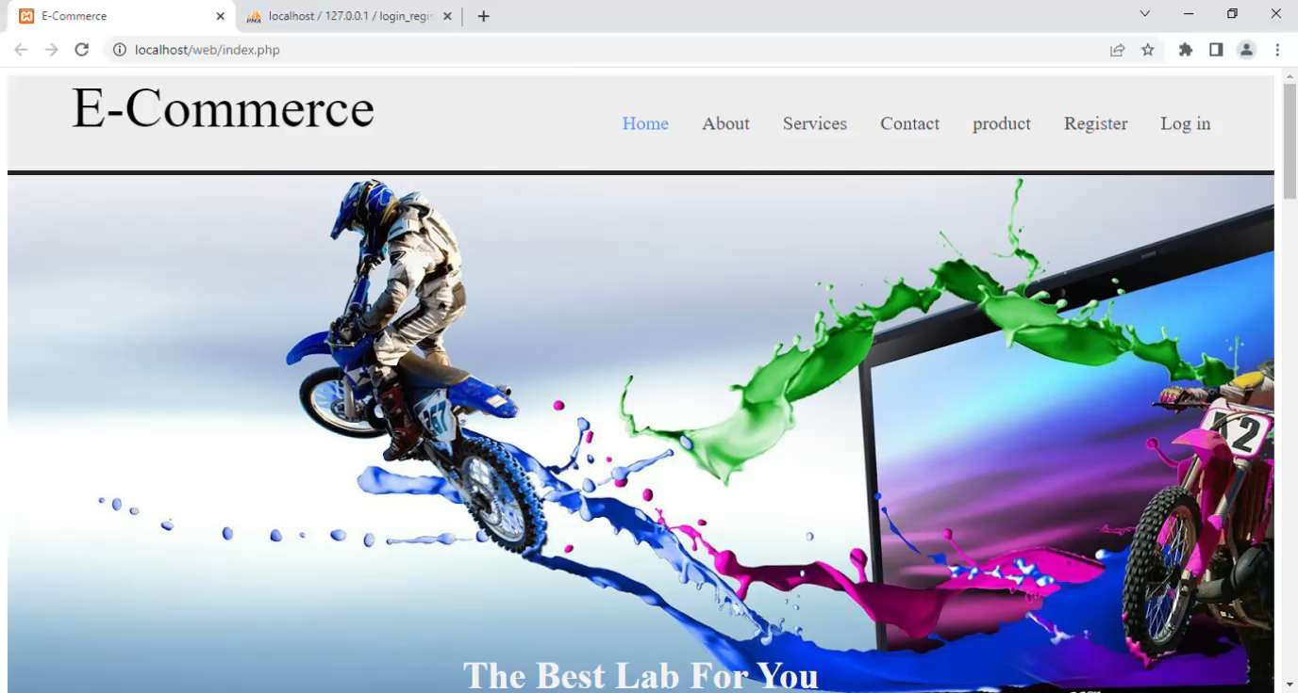
Home page :-
E-Commerce

Slide 12

Registration :-
E-Commerce

Slide 13
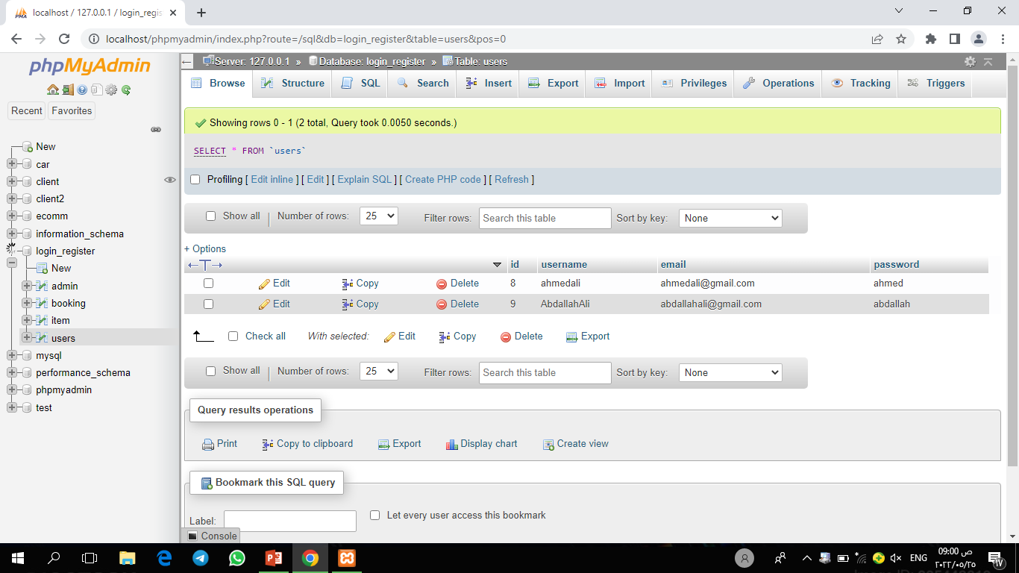
Registration :-
E-Commerce

Slide 14

Login For user :-
E-Commerce

Slide 15
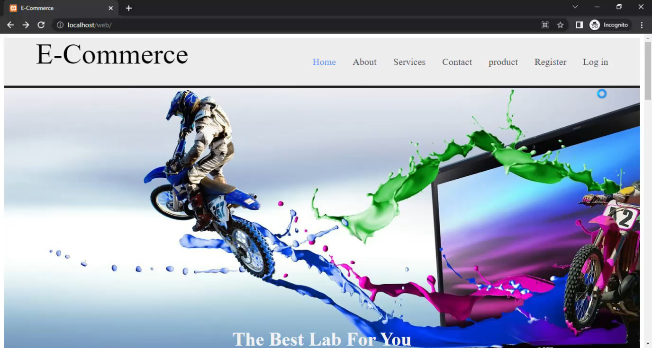
Login For Admin :-
E-Commerce

Slide 16
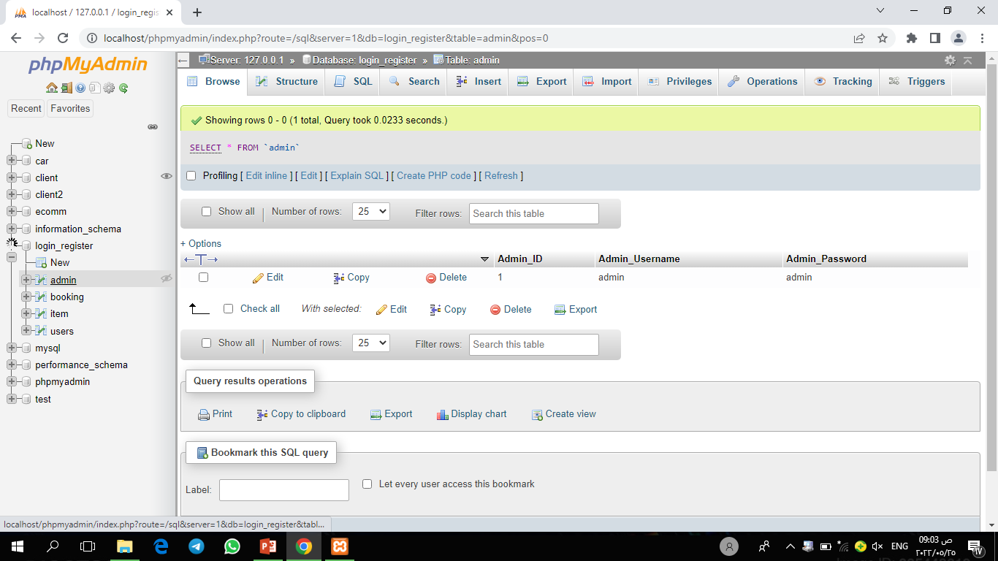
Login For Admin :-
E-Commerce

Slide 17
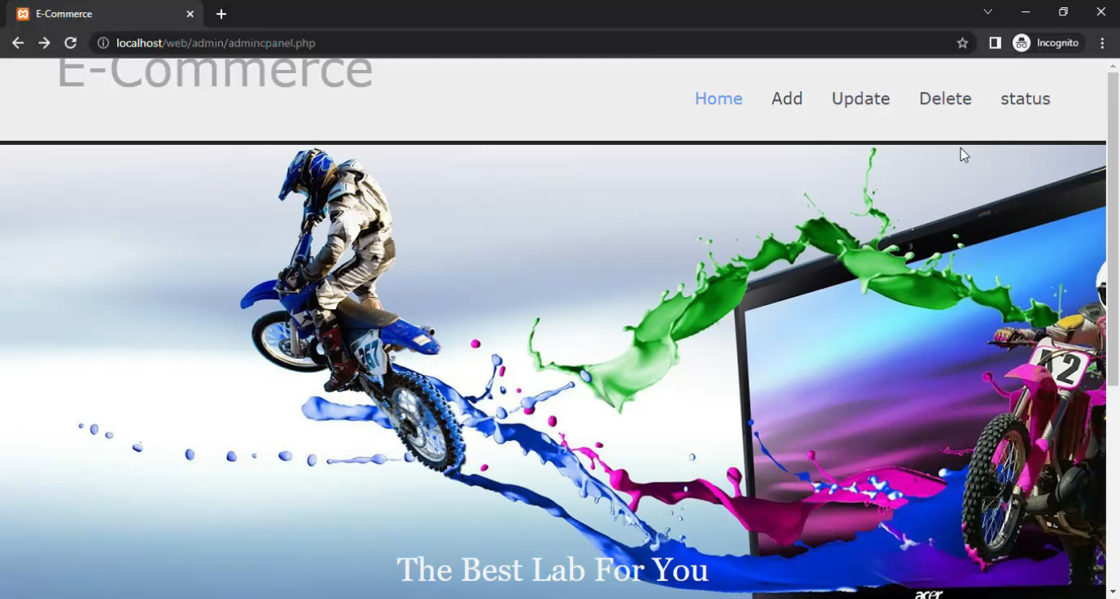
Add,Updata,Delete :-
E-Commerce

Slide 18
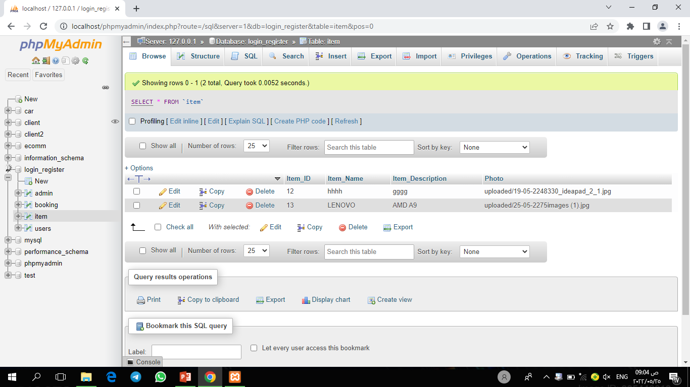
Add,Updata,Delete :-
E-Commerce

Slide 19

Booking :-
E-Commerce

Slide 20
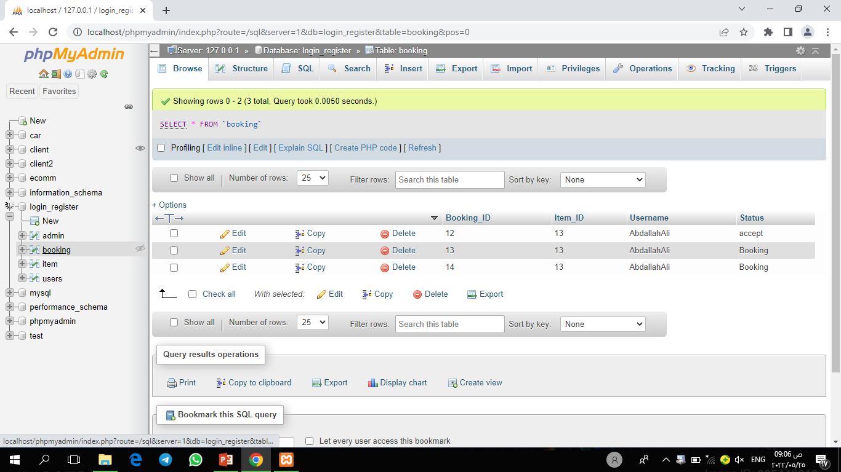
Booking :-
E-Commerce

Slide 21

Booking :-
E-Commerce

Slide 22
Conclusion :-
E-Commerce
After browsing the site, the user was able to take advantage of the site, such as buying any product from it and being able to obtain it.

Slide 23
Thanks
BY : Abdallah Ali Ahmed
Supervision : D.Hagar Saleh

